Slide 1

My Linear Relationships Interactive Notebook
Name
Class
Term 4 Semester 2

Slide 2
Contents
Formula Page
Page
Date
Description

Slide 3
Tasks
24
7
30
Essential Question
Questions
Notes
Summary

Slide 4
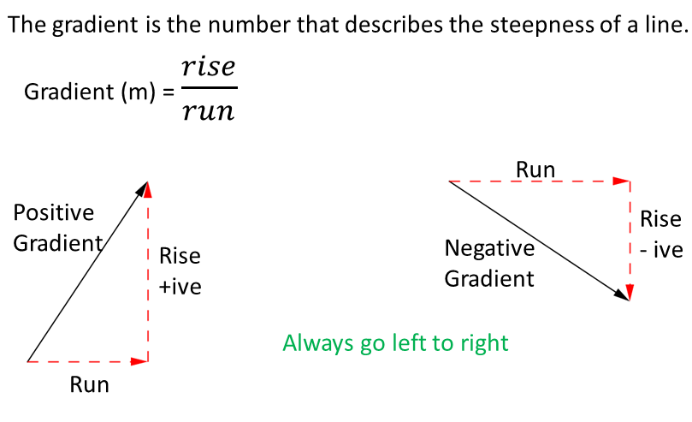
24
7
30
Date
Gradient
EQ – Describe how the gradient is calculated?

Slide 5
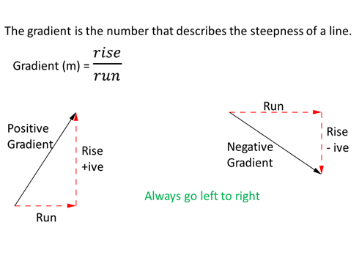
24
7
30
Date
Gradient
EQ – Describe how the gradient is calculated?

Slide 6
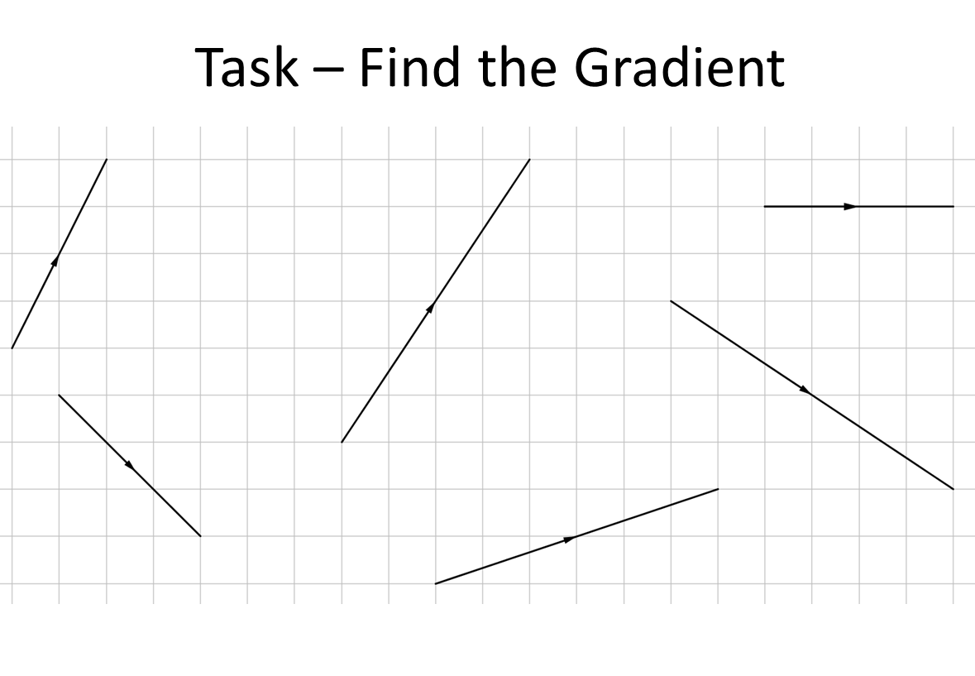

Slide 7
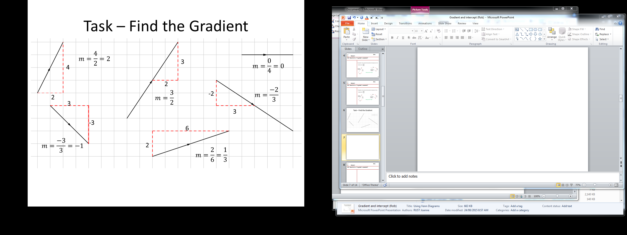

Slide 8
24
7
30
Date
Gradient
EQ – Describe how the gradient is calculated?

Slide 9
Questions Exercise 16.6 & 16.7 Pages 218 - 219

Slide 10
Notes Review
24, 7 ,30
Date
Title
Essential question
Notes complete
Notes complete with colour and diagrams
Questions completed
Contents page filed in
Formula page filled in

Slide 11
Homework
Review your notes and write a summary answering the essential question.

